Slide 1
GAME PROGRAMMING I
Week 1
Notes:
It's my pleasure to give you a warm welcome to an experience that will change the way you think and subsequently the way you work. It’s my pleasure to mold your minds about one of the most important aspects of this program.
Let’s take a walk through… CODE!
How many of your have a laptop? If you do, bring it.

Slide 2

Who are you?
Why are you here?
What’s your commute like?
Do you have any experience with code?
What is the story behind your shoes?
What is the meaning of life death?

Slide 3
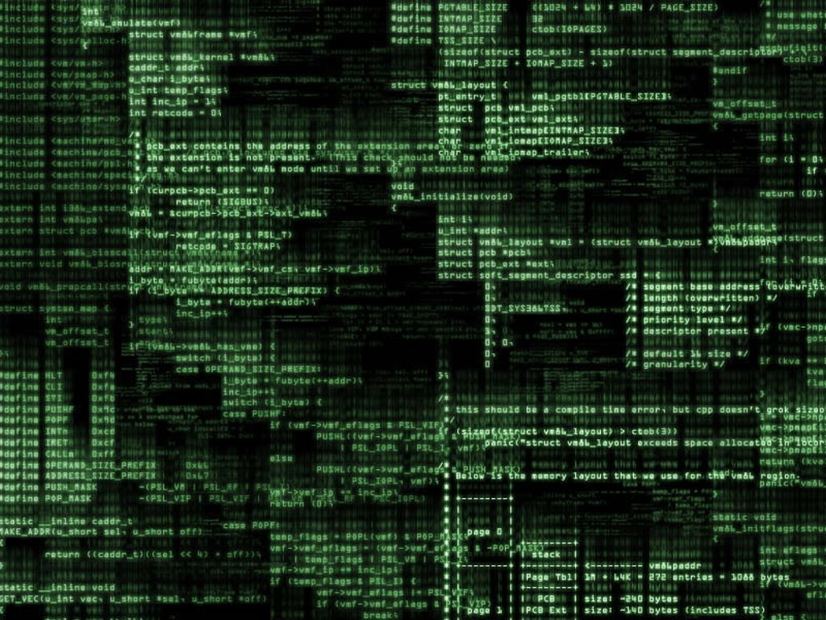
Notes:
Code has been around for ever… It's essentially recipes for dealing with information and understanding out world.
Code is everywhere…

Slide 4
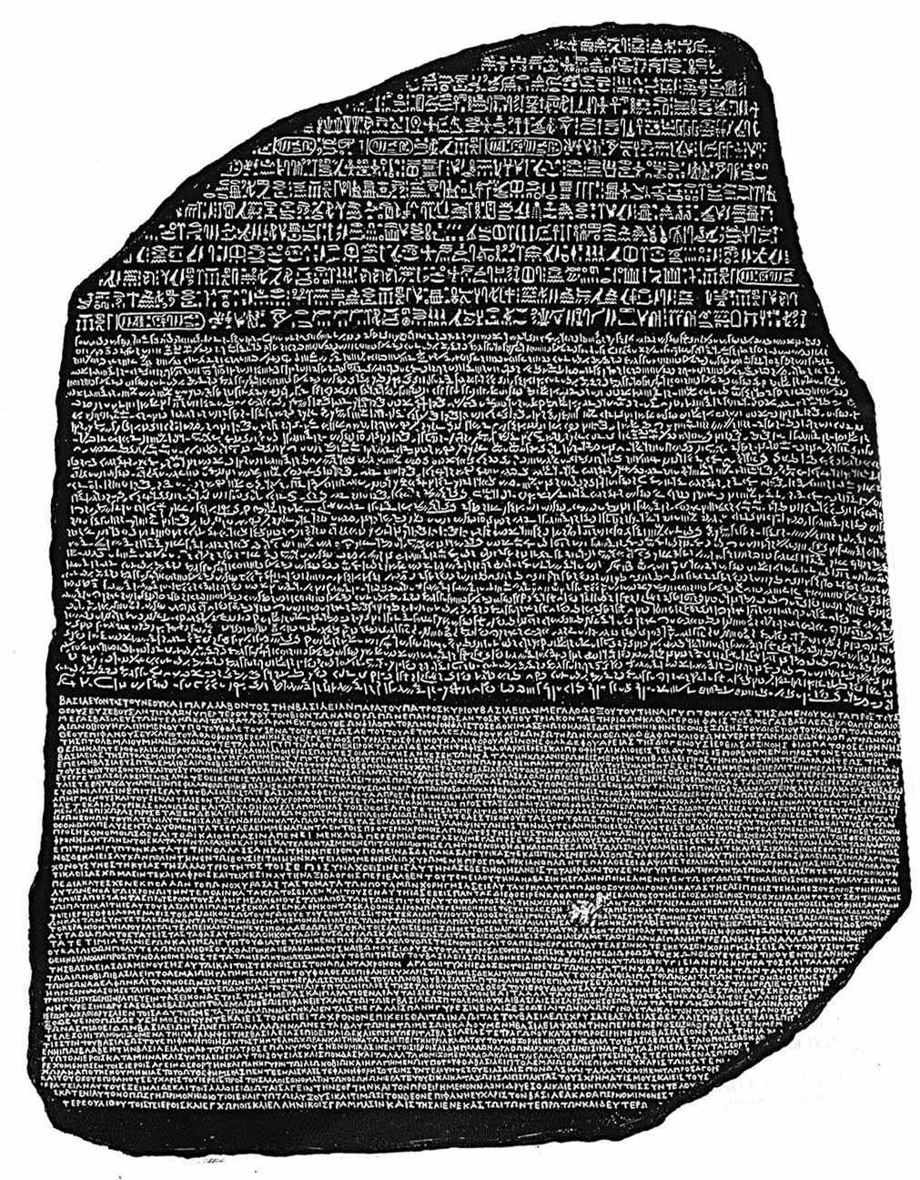
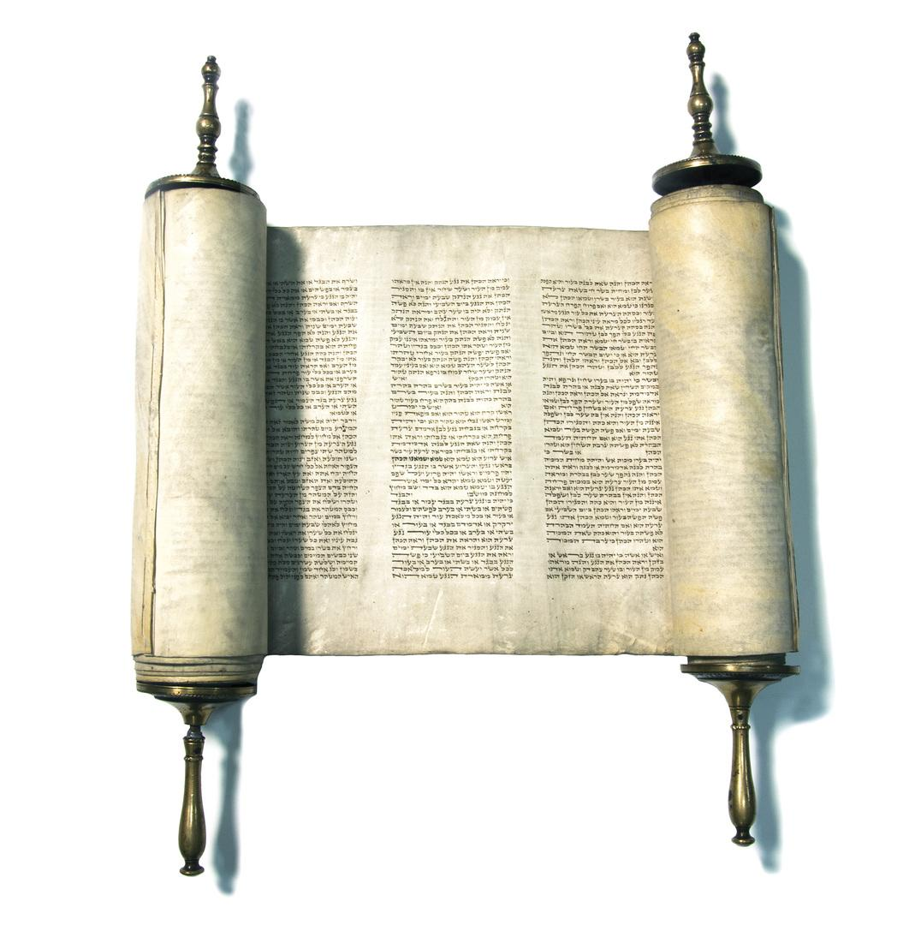
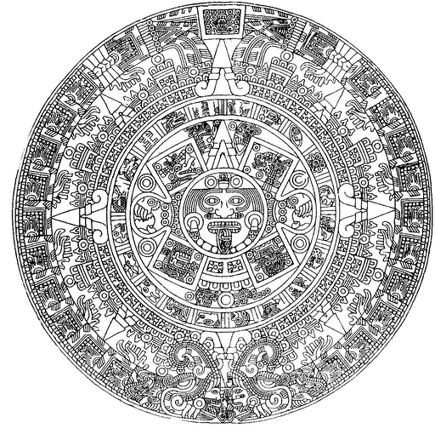
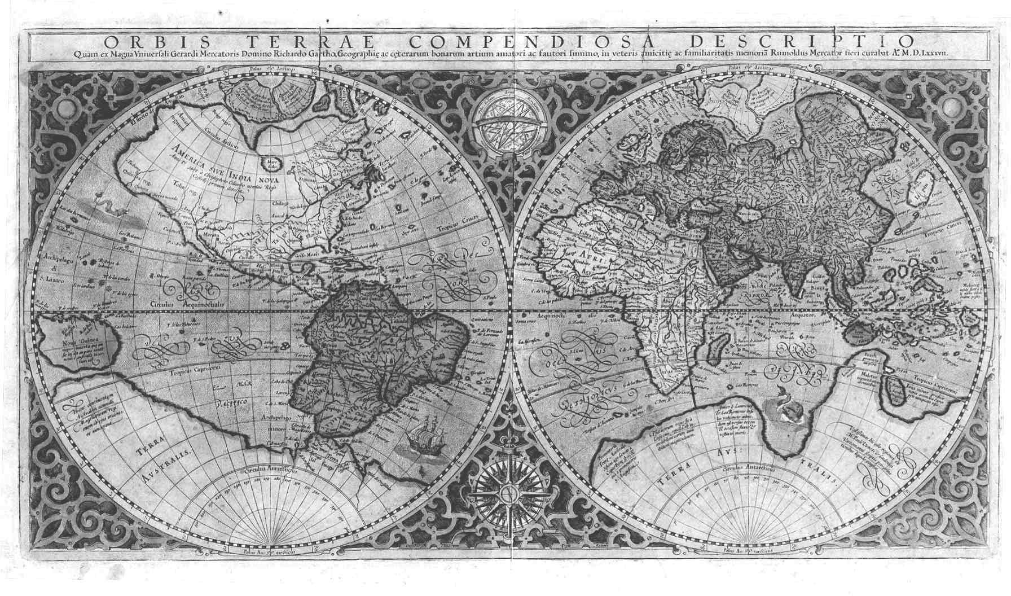
Notes:
in our history, beliefs, understanding of space and time

Slide 5
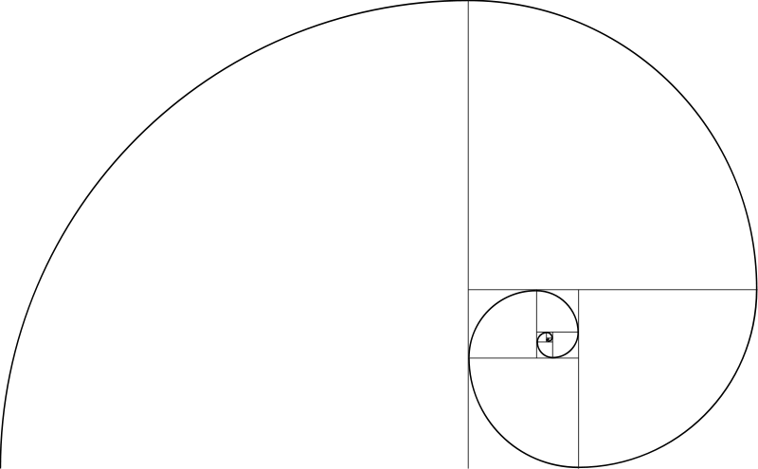
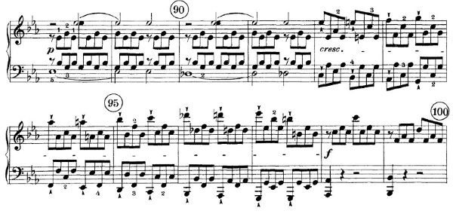
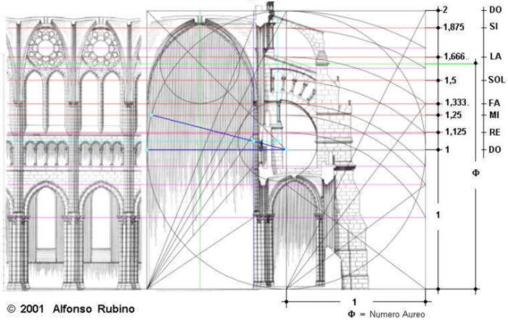
Notes:
It’s in the way we build, create, design, and communicate… Like I said, it’s everywhere.
Code contains ELEMENTS organized in PATTERNS according to RULES.
Think of code as RECIPIES of PROCESS... as MEMORIES of experiences.
Now that we understand the importance of code, let’s look around and see how much of our every-day life is influenced by code?

Slide 6
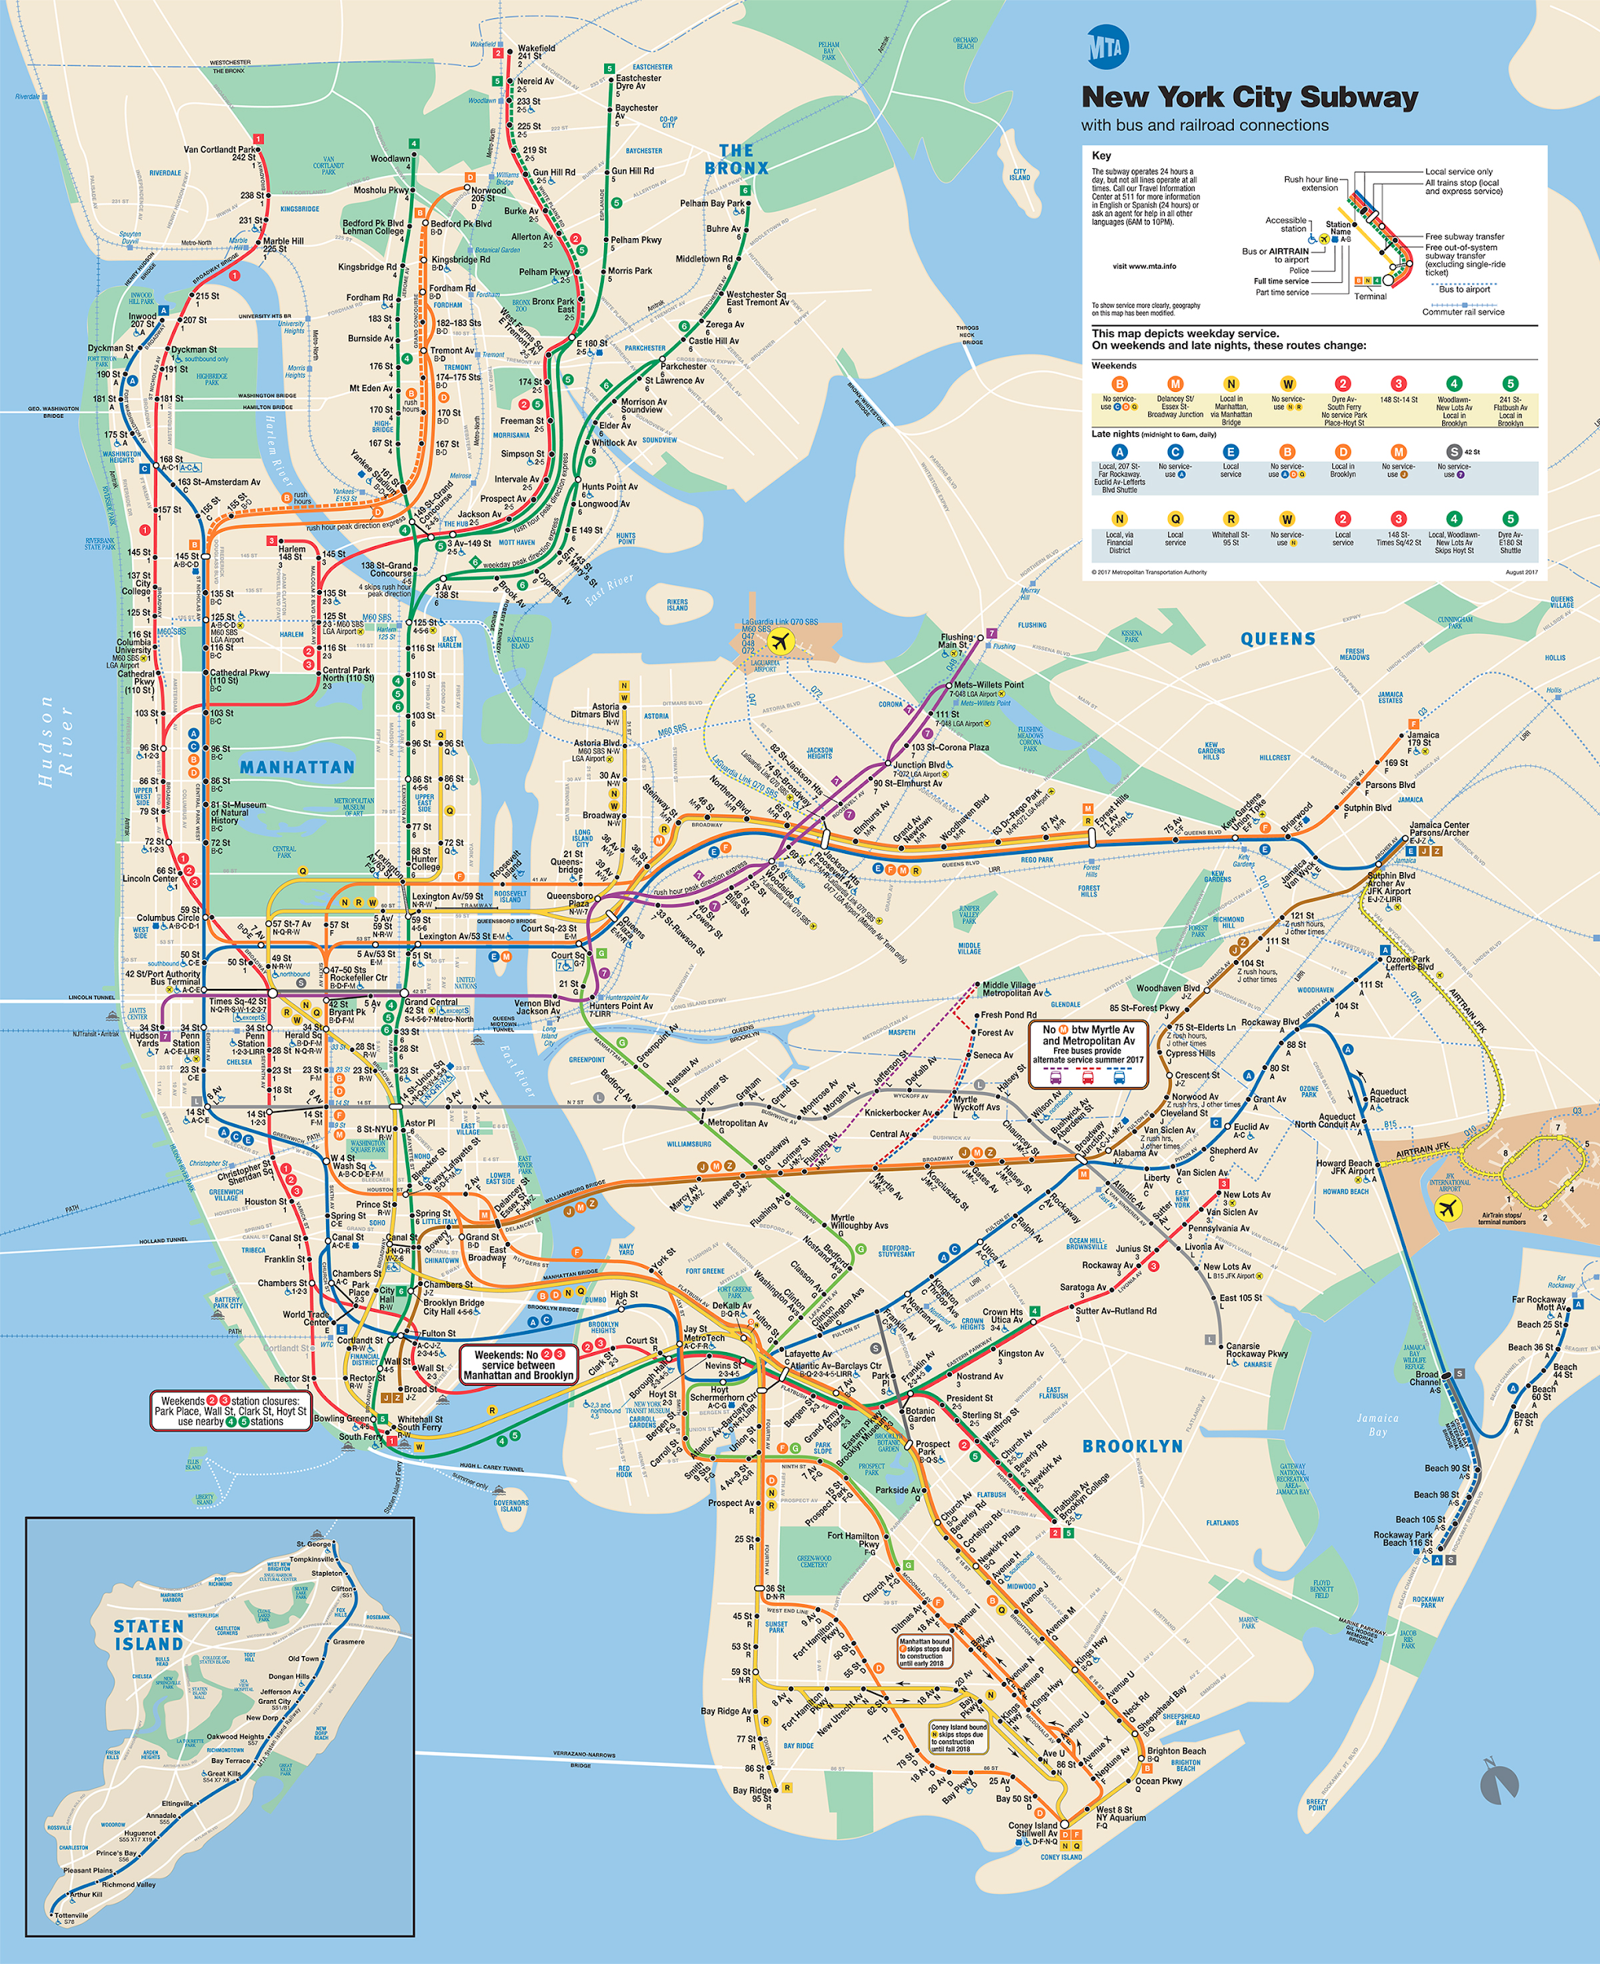
Notes:
(subway, elevators, shopping, hospitals, schools, cellphones, death forms)
Now give me some examples.

Slide 7

Notes:
How many afraid of math?
How many love math?
I failed

Slide 8
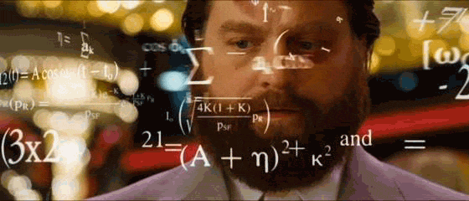

Slide 9
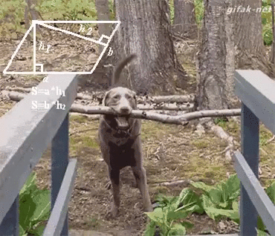
KNOWLEDGE IS POWER, etc.

Slide 10
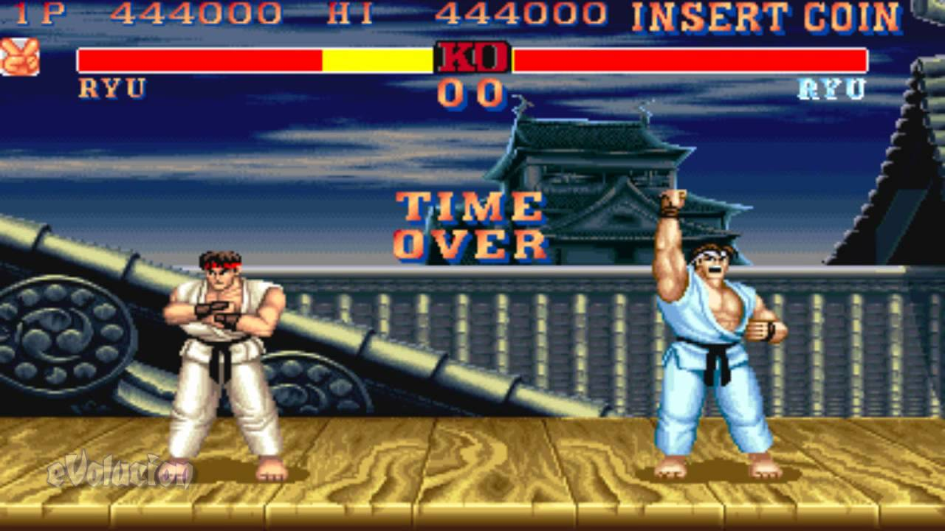
Favorite Digital Game?
Notes:
How does it work?
We become users and technology a black box.
LITERACY IS IMPORTANT
Most of us have a very superficial understanding of what happens behind an email, a google search, pressing a button on an elevator, etc.

Slide 11
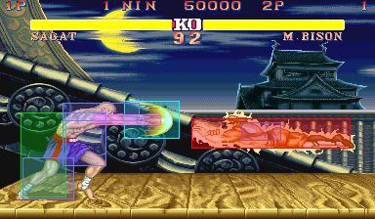

Slide 12

Notes:
We are users of technology and code, thus it’s important that we understand how it works.
Most of us have a very superficial understanding of what happens behind an email, a google search, pressing a button on an elevator, etc.

Slide 13
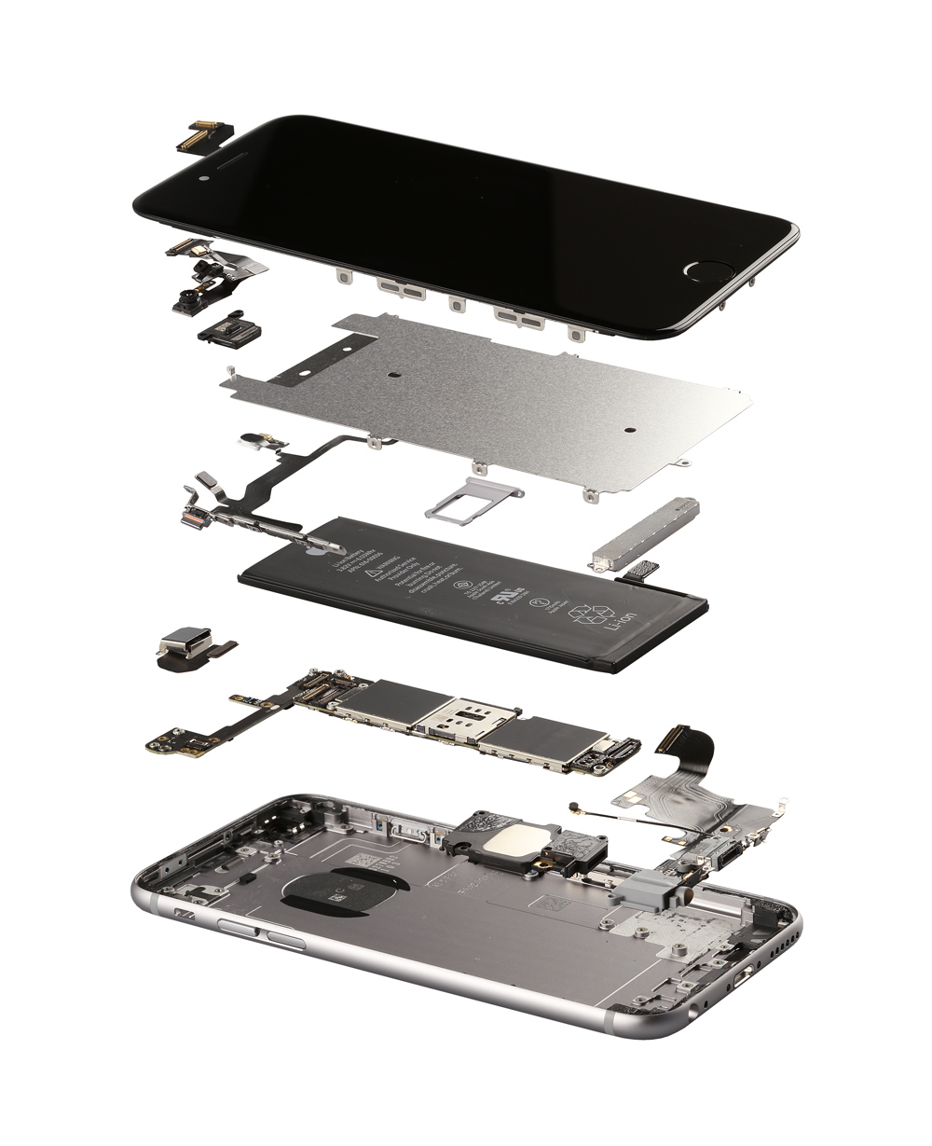
Notes:
As game designers/artists part of our job is to know the rules, play with them, expose them or blend them. ( avatar blenders )
( IMAGE )
GOLAN'S TOY KIT???
VISUALIZATION??
ARBM CITIES

Slide 14
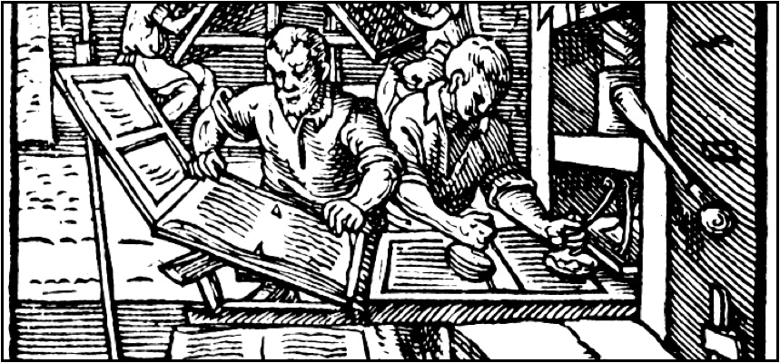
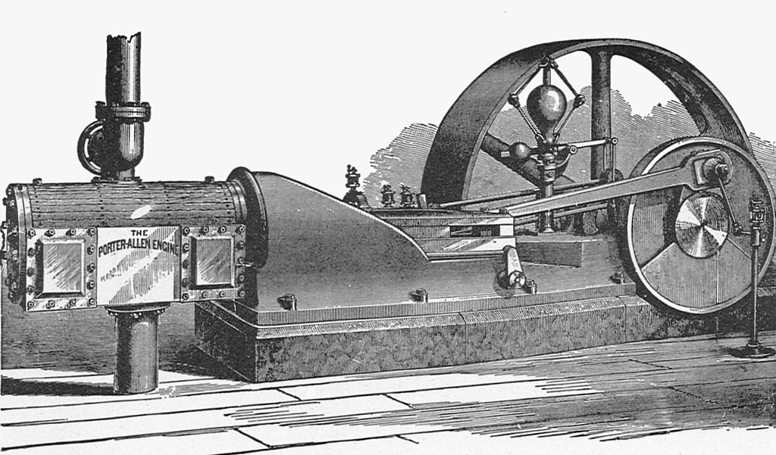
Notes:
Knowing code today is the equivalent of learning printmaking in the renaissance, or understanding the power and significance of machines of the industrial age.
Code will give us the power to understand how the world around is constructed and how it works.
Gives us the power to stop being users and start being makers.

Slide 15
Now Let’s Code
Notes:
I need a volunteer from the audience

Slide 16
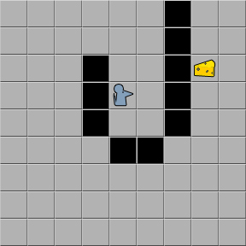
Notes:
I am a hungry mouse… I want some cheese… What program do I use to get the cheese?
(Now we program our classmates)

Slide 17
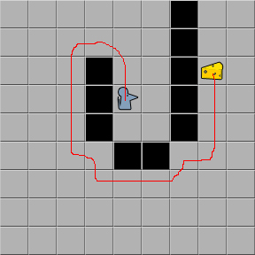
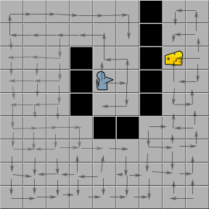
Program Your Classmates
Notes:
(Now we program our classmates)

Slide 18
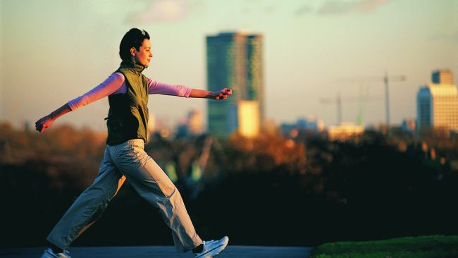
Notes:
How do we code for this?

Slide 19
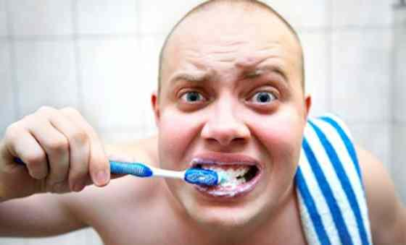
Notes:
How do we code for this?

Slide 20
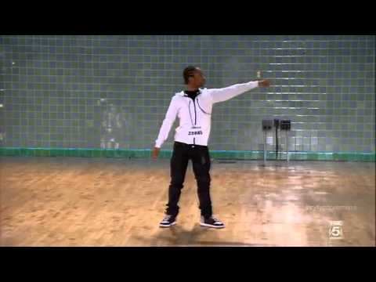
Notes:
Now that we are programing experts… let’s write the code for this

Slide 21
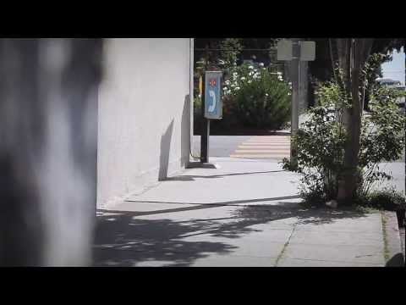
Notes:
computers dont make mistakes. computers follow rules. humans make mistakes

Slide 22


Notes:
We have code. In the old days, this code would have been proprietary, meaning it would not be open to everyone. Today we do things differently.
Everyone wants to know how to dance… so we make the dancing code transparent, meaning it’s available to all.

Slide 23
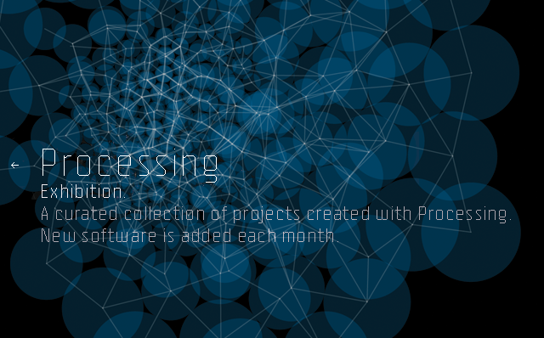
Notes:
One of the best tools to use as a gateway to the world of code is called Processing. It is opensource, versatile, and easy to use.
So what can we do with Processing?

Slide 24
Games

Slide 25
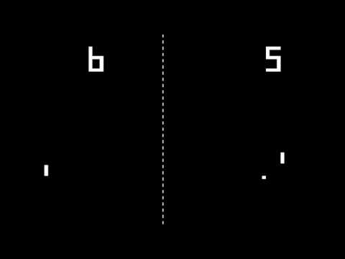
(http://www.openprocessing.org/sketch/105783)
Notes:
GAMES

Slide 26
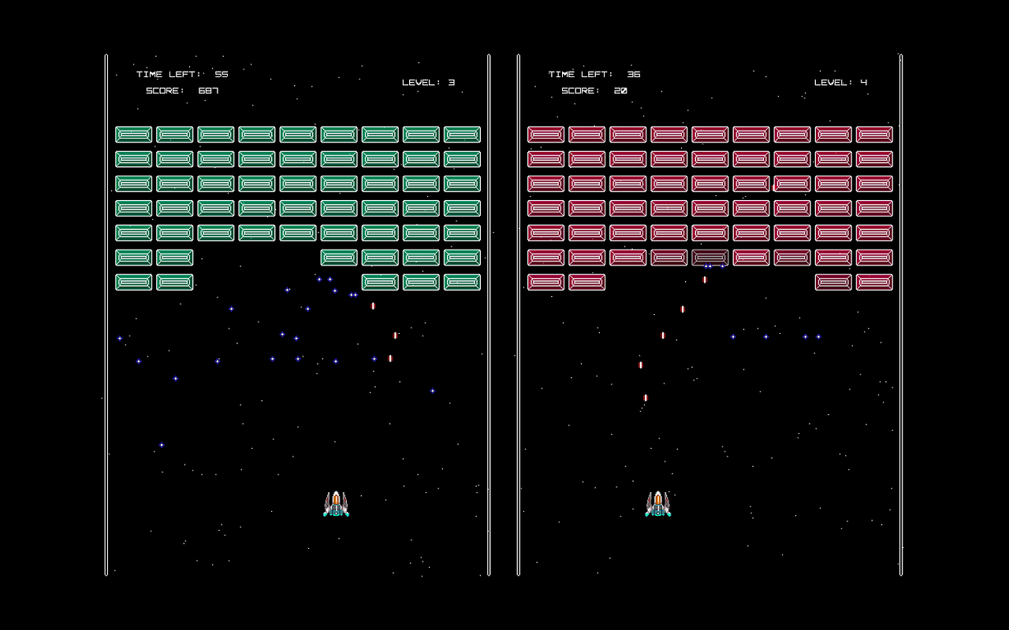
http://vimeo.com/82228292 by Daniel
Notes:
and make games.

Slide 27
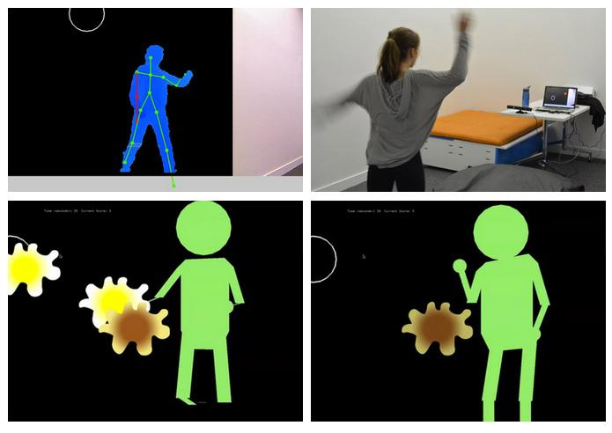
http://vimeo.com/81973061 Food Fight game by Julie

Slide 28
Physical Computing
(HUH???)
Notes:
What is that?!!
wearables!
3D Printing!!!
sound & light installations!!
internet of things citizen science
Big Projection Mappings
games
RasperryPi/Arduino

Slide 29
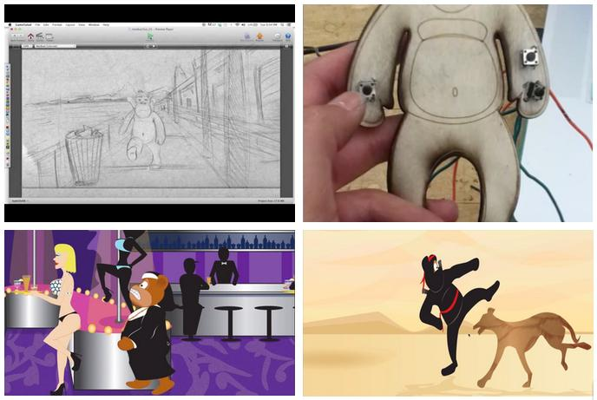
https://www.youtube.com/watch?v=34FwuOnvjK0
Office Monkey stress doll by Kamille Rodriguez
Notes:
If you're anything like me, you are thinking to yourself right now:
“Coding sounds awesome, but will I be making anything tangible in the physical world that I can interact with and manipulate?
The answer is YES!!... this is what we call physical computing

Slide 30
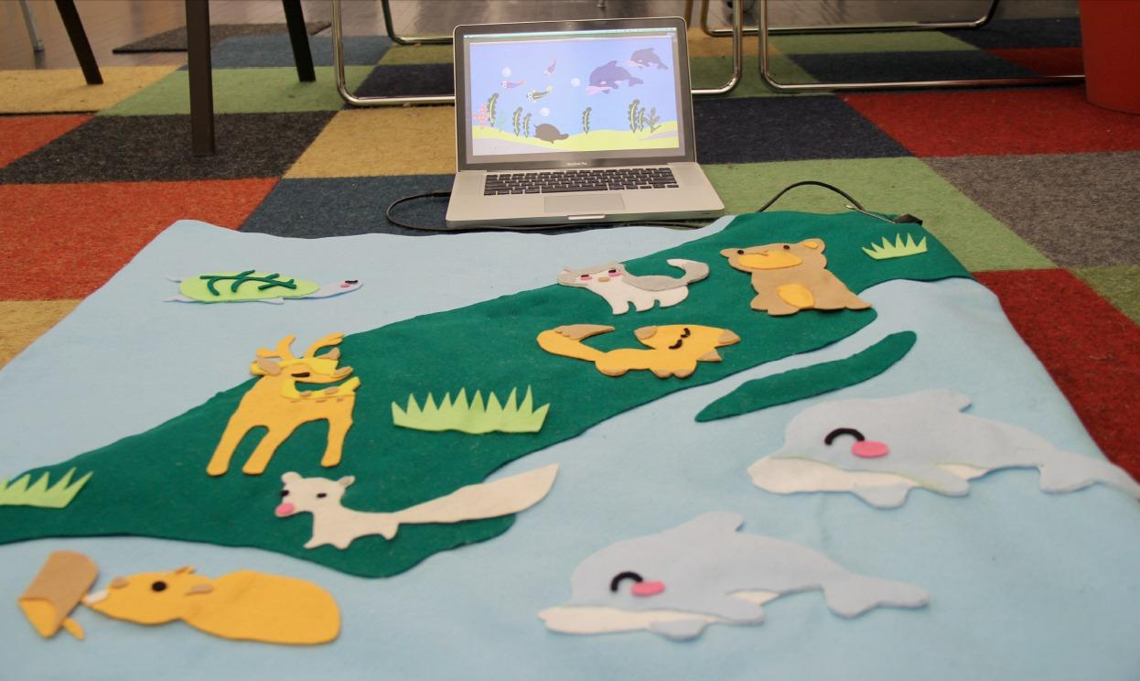
http://vimeo.com/81977499
Interactive storytelling baby blanket by Feng Yuan
Notes:
With the power of Processing and Arduino… you can build your interactive world.

Slide 31
Video & Visualization

Slide 32
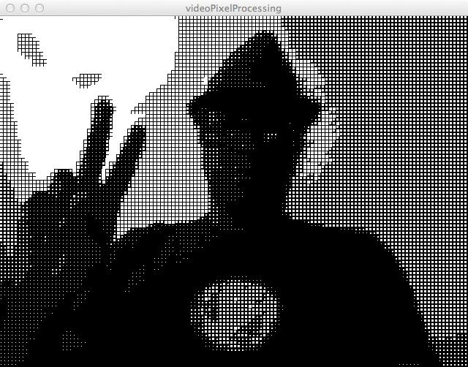
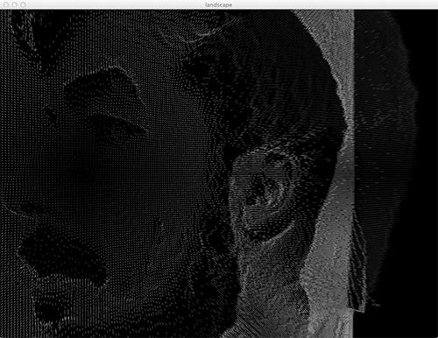
VideoPixel Processing / Landscape by Bryan
(see misc. CODE folder for examles)

Slide 33
www.processing.org
Notes:
Now that you know the possibilities… let’s download Processing and give it a twirl

Slide 34
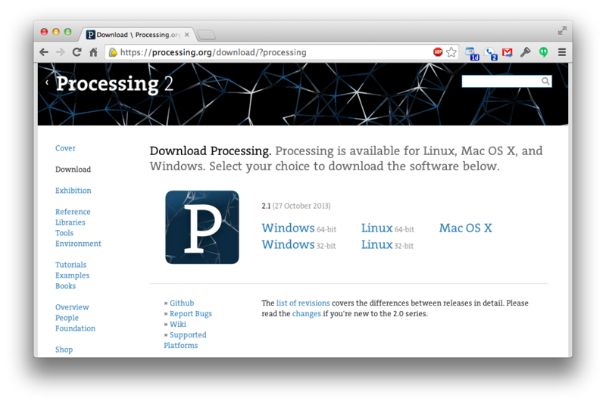
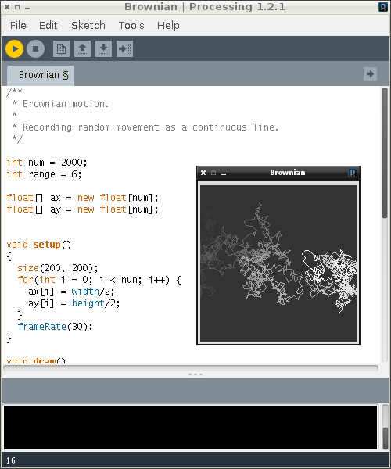

Notes:
download and install processing

Slide 35
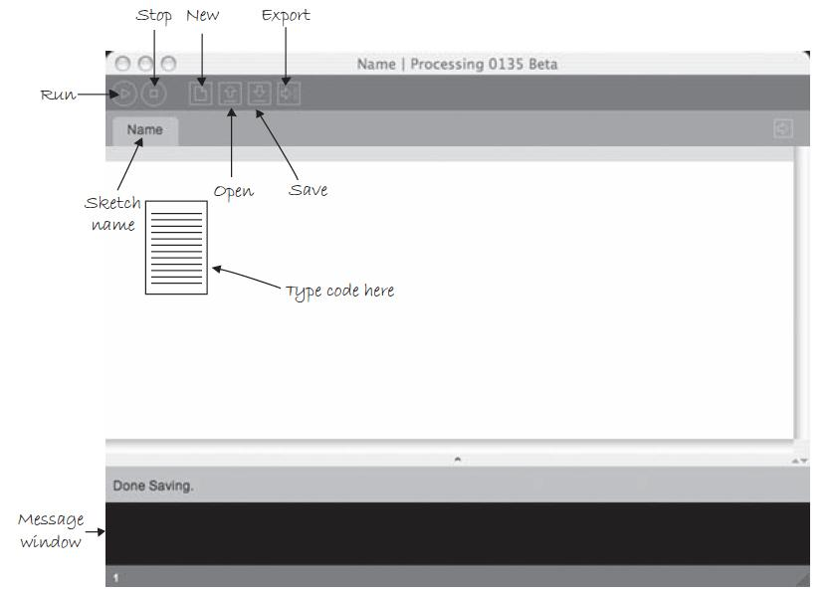
Notes:
Processing IDE
An integrated development environment (IDE) or interactive development environment is a software application that provides comprehensive facilities to computer programmers for software development.
Run through application options

Slide 36
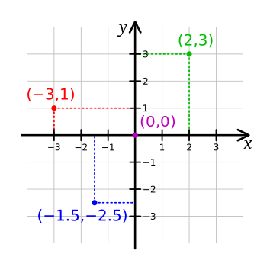
Coordinates
Notes:
Cartesian coordinate systems

Slide 37
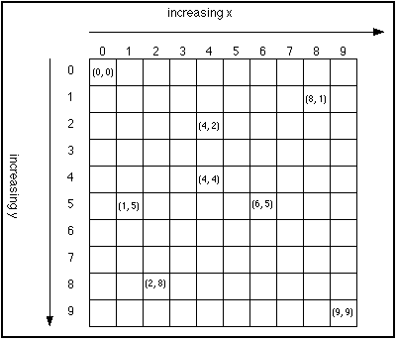

Slide 38
Shapes
rect(x, y, w, h);
ellipse(x, y, w, h);
x = starting x position
y = starting y position
w = shape width
h = shape height
line(x1, y1, x2, y2);
x1- starting x position
y1- starting y position
x2 - ending x position
y2 - ending y position

Slide 39
Basic commands
size(w, h);
w = desired window width
h = desired window height
width: "keyword" which gets set to the canvas width
height: "keyword" which gets set to the canvas height
background(r,g,b);
r = red value
g = green value
b = blue value
Notes:
mention width & height built-in variables

Slide 40
Attributes of Shapes - Fill
fill(r,g,b);
Set the fill color
r = red value
g = green value
b = blue value
noFill();
Removes fill
Notes:
rectMode(), ellipseMode()

Slide 41
WAIT – WHAT'S WITH ALL THOSE SYMBOLS?(;!
Notes:
notice the winking smiley face

Slide 42
Syntax
parameters
semicolon
size(800, 600);
function name
parentheses
Notes:
parameters are sometimes also referred to as arguments or options
even if there are no parameters, you will need an empty set of parentheses
DON'T FORGET YOUR SEMICOLONS

Slide 43
ellipse(50, 50, 80, 80);
rect(30,30,50,50);
line(30,30,50,50);
Notes:
now let’s try these.
see Welcome EX1

Slide 44
size(480, 120);
quad(158, 55, 199, 14, 392, 66, 351, 107);
triangle(347, 54, 392, 9, 392, 66);
triangle(158, 55, 290, 91, 290, 112);
Notes:
more complex shapes
see Welcome EX1

Slide 45
size(480, 120);
background(100,25,50);
fill(100); // gray 0 to 255
quad(158, 55, 199, 14, 392, 66, 351, 107);
fill(255,0,0); //(RGB) 255 RED, 0 GREEN, 0 BLUE
triangle(347, 54, 392, 9, 392, 66);
fill(0,0,255,50); //(RGBA) 0 RED, 0 GREEN, 255 BLUE, 50 ALPHA
triangle(158, 55, 290, 91, 290, 112);
Notes:
now with color
What if we want to SETUP a world, not just DRAW shapes.
To do this we need to understand the syntax and structure of Processing.
see Welcome EX1

Slide 46
Media Platforms
OpenProcessing Class - for assignment submissions, examples from class
openprocessing.org/class/56360/
Ryver Team - for communication, assignment descriptions, extra credit, etc.
hostosmdp.ryver.com

Slide 47
declaration;
ONCE
ONCE
LOOP
void setup() {
our code goes here;
//we comment here
}
void draw() {
our code goes here;
//we comment here
}
Notes:
Now let’s build a sketch
SETUP sets up your environment… it defines elements that run once
DRAW runs through the code and repeats once it reaches the end
{ Opens a code block
} Closes a code block
; goes at the end of code statements
// Comments

Slide 48
How do I submit my homework?

Slide 49
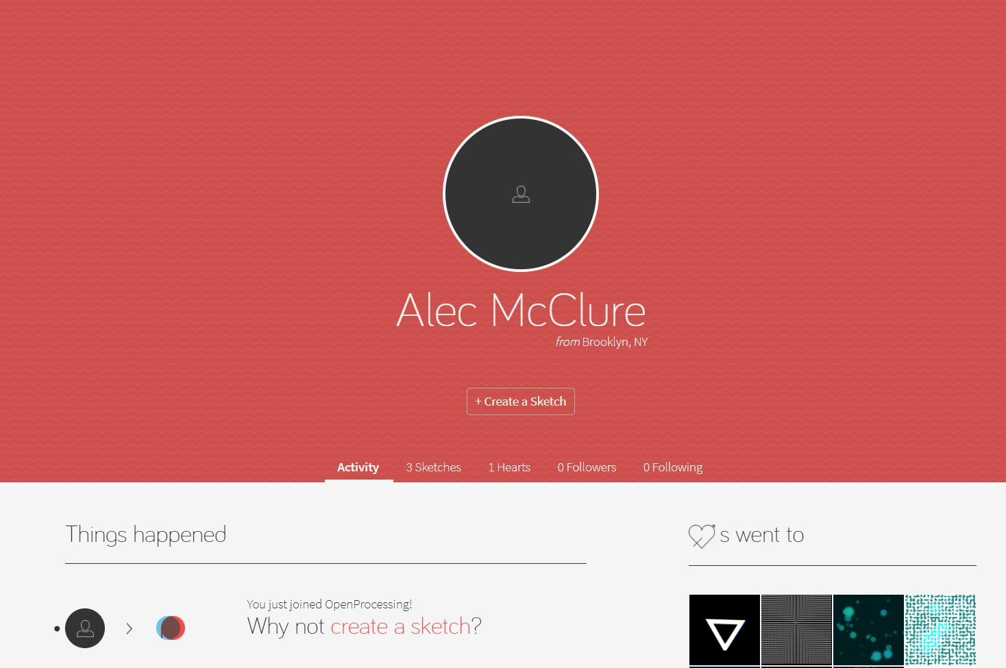
Select “Create a Sketch” on openProcessing

Slide 50
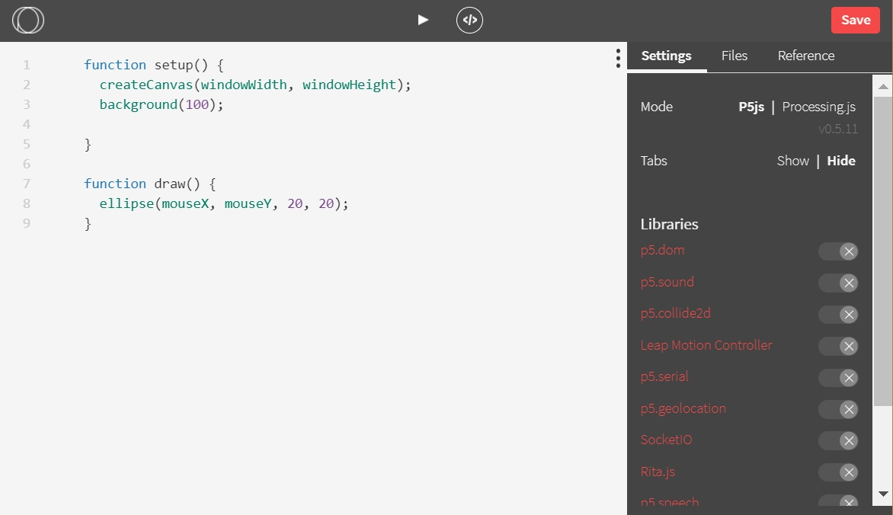
On the right side, select “Processing.js”

Slide 51
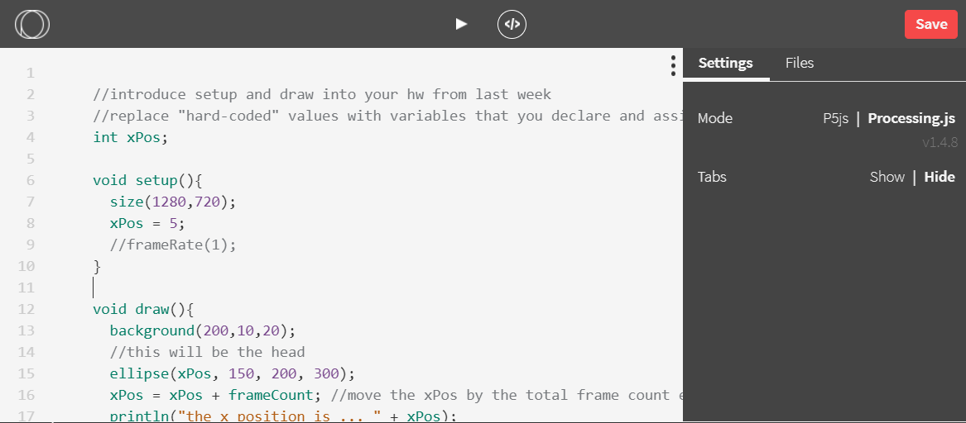
Paste the body of your code into the window

Slide 52
Test your sketch with the play button to make sure it works

Slide 53
Save your sketch and don’t forget the assignment title!

Slide 54
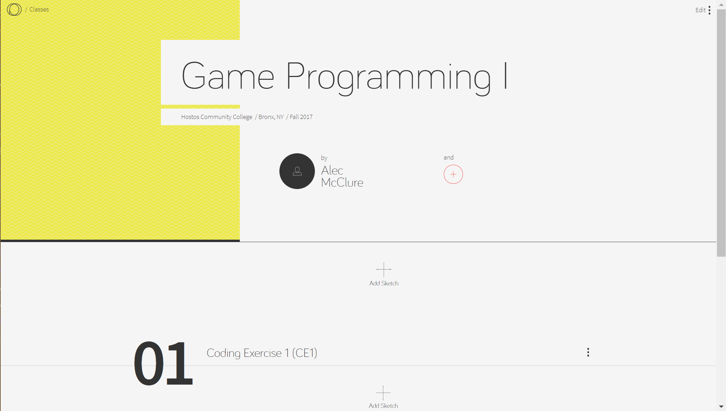
Once saved, navigate to the class oP page and hit “Add Sketch” under the appropriate assignment name

Slide 55
Homework
DRAW:
A self-portrait using the elements we used in class today. Find and utilize 4 new functions or things in the Processing documentation.
Gold stars if you can make it interactive with the mouse

